Slide 1
Introduction
The project aims to generate electricity with rooftop air-ventilator where wind speed acts as an input to rotate the axial flux permanent magnet generator. Also we have clubbed solar panels with our project to increase the efficiency and promote the use of renewable energy for a better and sustainable future.

Slide 2
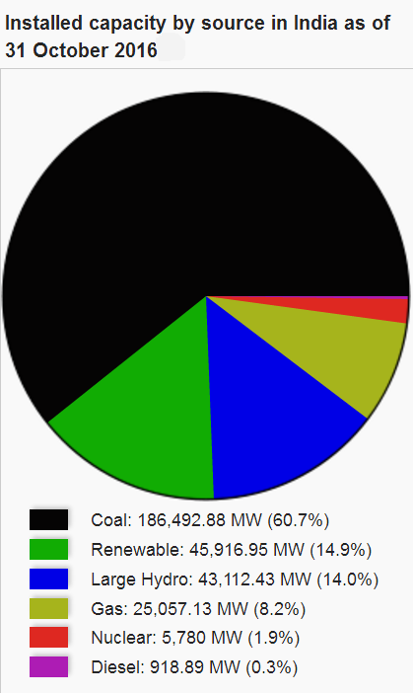
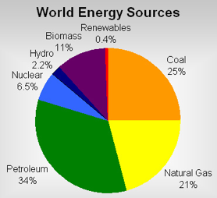
Energy Scenario
The ever ending demand for electrical power has led to widening of electricity demand - supply gap, which has compelled researchers to enhance the power production from Renewable sources of energy like solar, wind etc. trying out every possible ways.

Slide 3
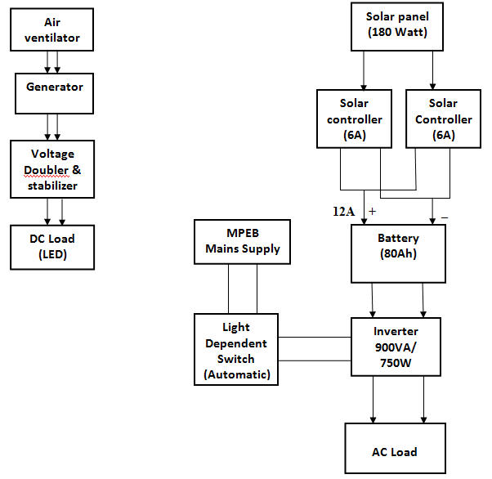
Block Diagram

Slide 4
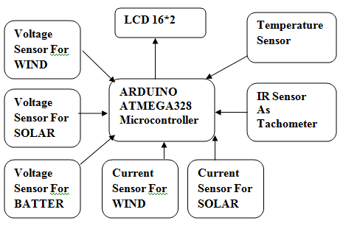
Energy Monitoring Block Diagram

Slide 5
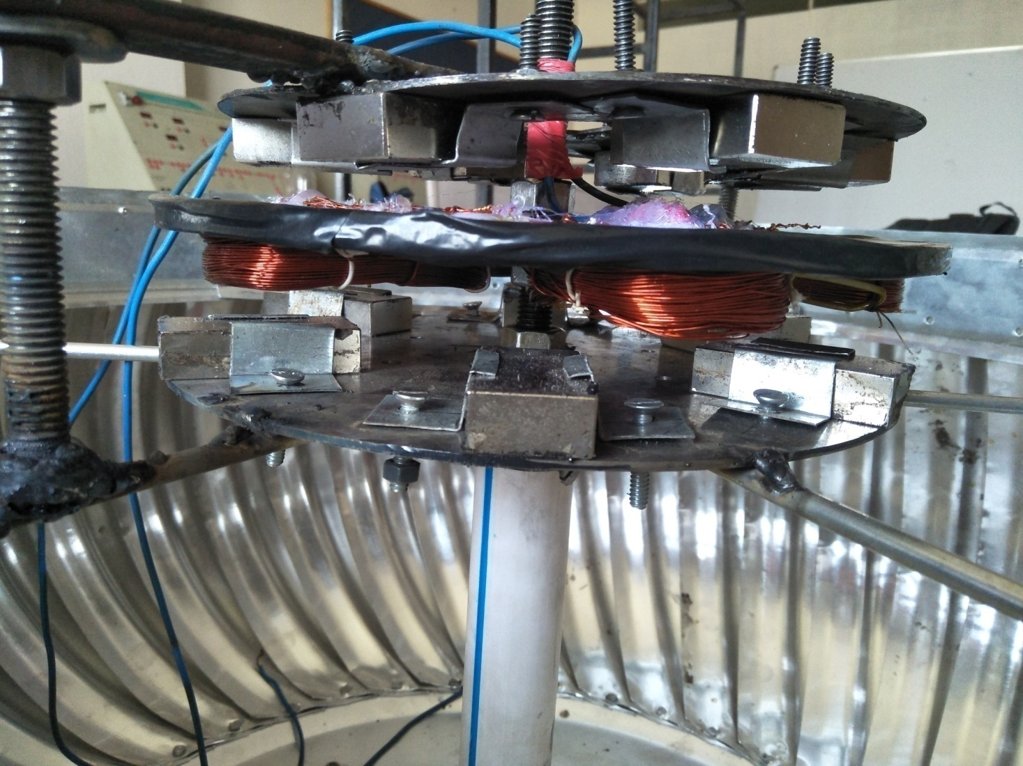
Design Structure

Slide 6
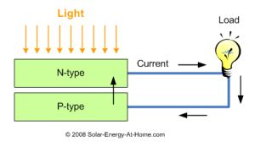
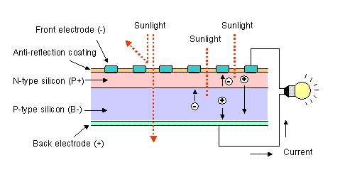
Solar Energy Conversion:
Solar electric systems use solar cells to convert the Sun's radiant energy into electricity. This is done using a principle known as the photovoltaic effect.

Slide 7
Components Used
Roof Top Air Ventilator.
Electricity Generator.
Voltage Doubler & Stabilizer.
Solar Panels.
Solar Charge Controllers.
Battery & Inverter set.
LDR based Automatic Switch.
Parameters Monitoring System.

Slide 8
Ventilator

Slide 9
Ventilator specifications :
Technical Specifications | Considered
Outer Diameter | 810 mm
Neck Diameter | 610 mm
Blade Thickness | 0.5 mm
Number of blades | 42
Type of blades | Aluminum
Approximate Weight | 6.5 kg
Center assembly | MS Galvanized

Slide 10
Generator

Slide 11
Axial flux type pancake PM generator
A permanent magnet generator is a device that converts mechanical energy to electrical energy. In this device the rotor windings have been replaced with permanent magnets. These devices do not require a separate DC supply for the excitation circuit or do they have slip rings and contact brushes.
In our project we are using a pancake type DC generator whose stator comprises of armature winding and rotor comprises of permanent magnet.

Slide 12
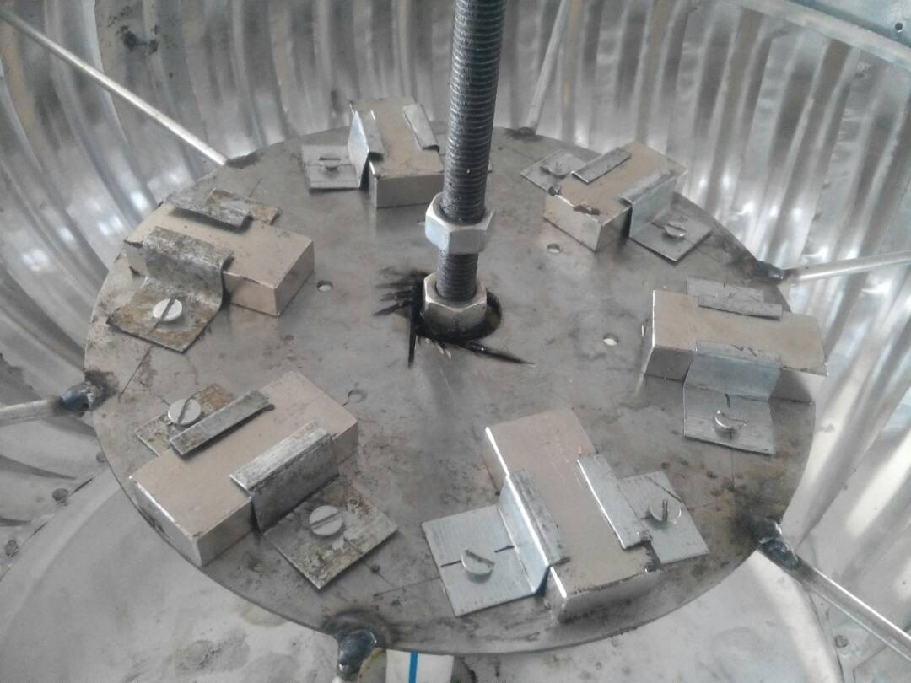
Rotor
A permanent magnet generator is a generator where the excitation field is provided by a permanent magnet instead of a coil.
Here the rotor Of our generator is a Permanent magnet type rotor which consists of 4 neodium magnets (one of the strongest magnet) whose grade is N52 . Magnets are placed 90 degree with each other.

Slide 13
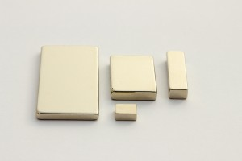
Neodymium Magnet
A neodymium magnet (also known as NdFeB, NIB or Neo magnet), the most widely used type of rare-earth magnet, is a permanent magnet made from an alloy of neodymium, iron and boron to form the Nd₂Fe₁₄B tetragonal crystalline structure.
The grade of neodymium magnets is generally measured in units millions of Gauss Oersted (MGOe). A magnet of grade N52 has a Maximum Energy Product of 52 MGOe. Generally speaking, the higher the grade, the stronger the magnet.

Slide 14
Specifications rotor:
Technical Specifications | Considered
Number of magnets in each Disc | 6
Length of each magnet | 5 cm
Breadth of each magnet | 1.5 cm
Height of each magnet | 1.25 cm
Strength of each magnet | 2.5 Wb
Material Of disc | Mild Steel
Diameter | 20cm

Slide 15
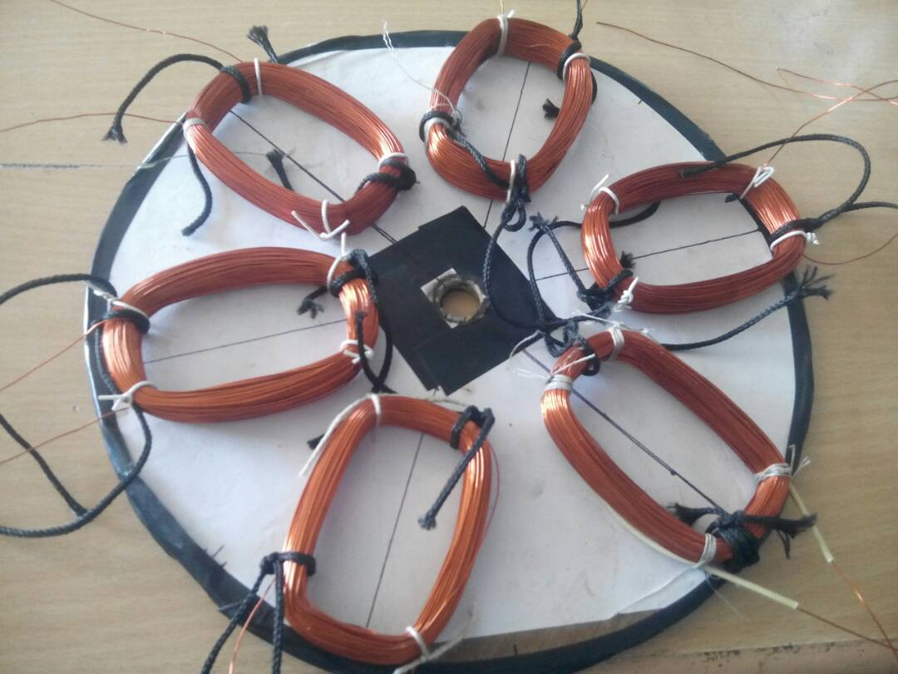
Stator
Stator is a static part of generator the armature winding of a Generator is almost invariably on the stator. The field winding is usually on the rotor and excited by dc current, or permanent magnets.
No: of Turns= 230
Number of coils= 6
Coil span= 5cm

Slide 16
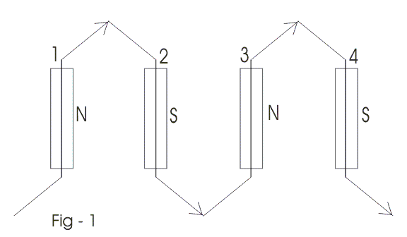
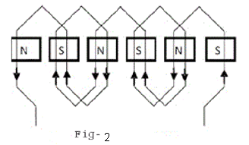
Types of Winding
CONCENTRATED WINDING: As name suggest, all conductor are concentrated in one slot under a pole. if there is only one slot available for winding under one pole. In very short, if slot = no. of pole, called concentrated winding.
DISTRIBUTED WINDING: As name suggest, all conductor are distributed in one slot under a pole. If no. of slot is more than no. of pole. Means, winding is distributed in many slot under a pole.

Slide 17
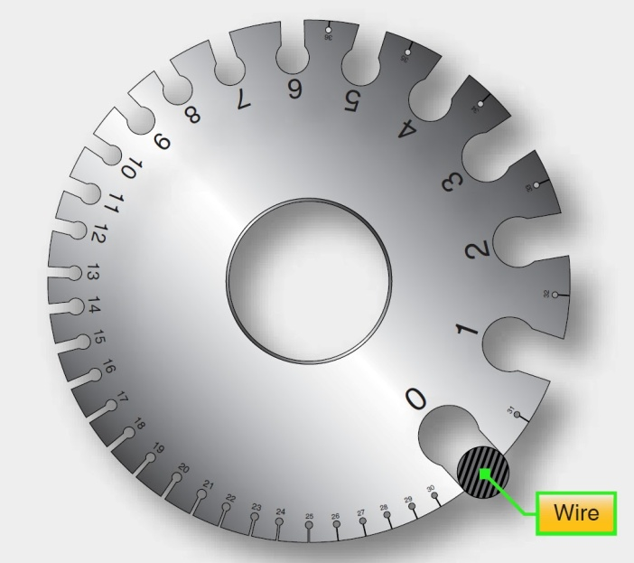
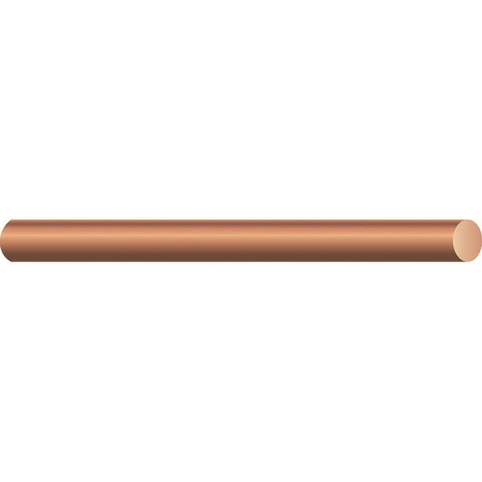
Wire Gauge:
Wire gauge is a measurement of how large a wire is, either in diameter or cross sectional area. This determines the amount of electric current a wire can safely carry, as well as its electrical resistance .
We have used 26gauge of winding wire in our project which induces

Slide 18
Specifications:
Technical Specifications | Considered
Diameter | 20cm
Material | Wood
Type of Winding | Distributed
Conductor Material | Copper (Cu)
Resistance of winding | 30 ohms
Phases | Single Phase
Gauge Of conductor | 26 swg

Slide 19
Voltage Doubler & Stabilizer
Voltage Doubler: The Voltage Multiplier, however, is a special type of diode rectifier circuit which can potentially produce an output voltage many times greater than of the applied input voltage. where it is necessary to have a very high DC voltage generated from a relatively low AC supply.
Voltage Stabilizer: It stabilizes the variable Input DC voltage into Constant DC voltage.

Slide 20
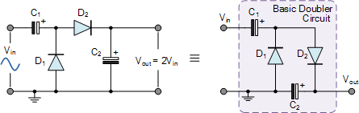
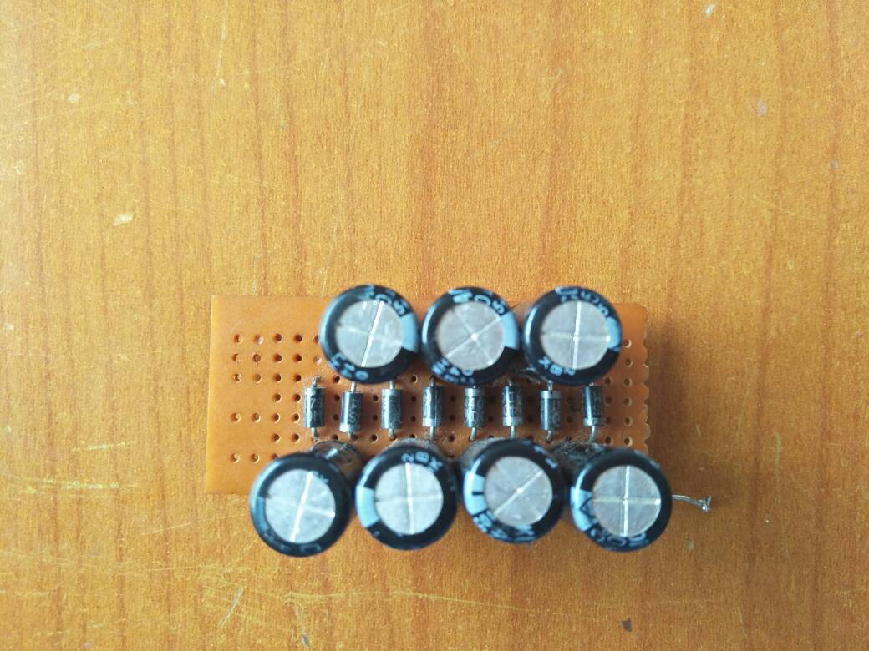
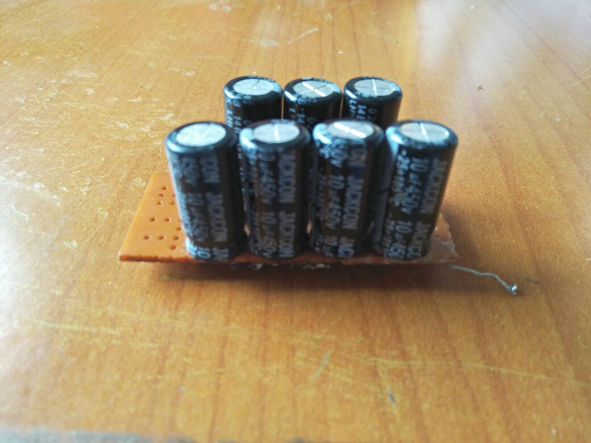
Voltage Doubler

Slide 21
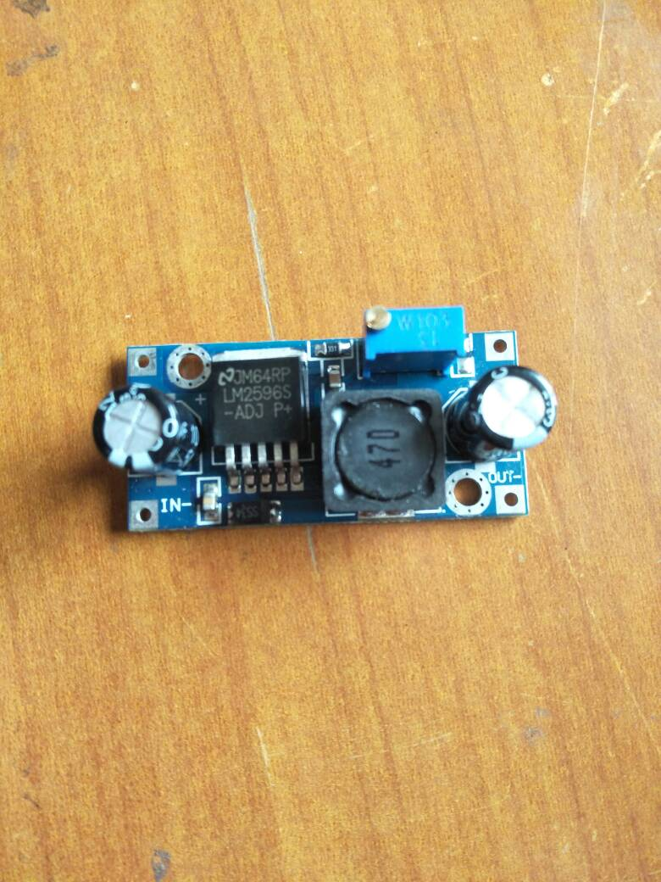
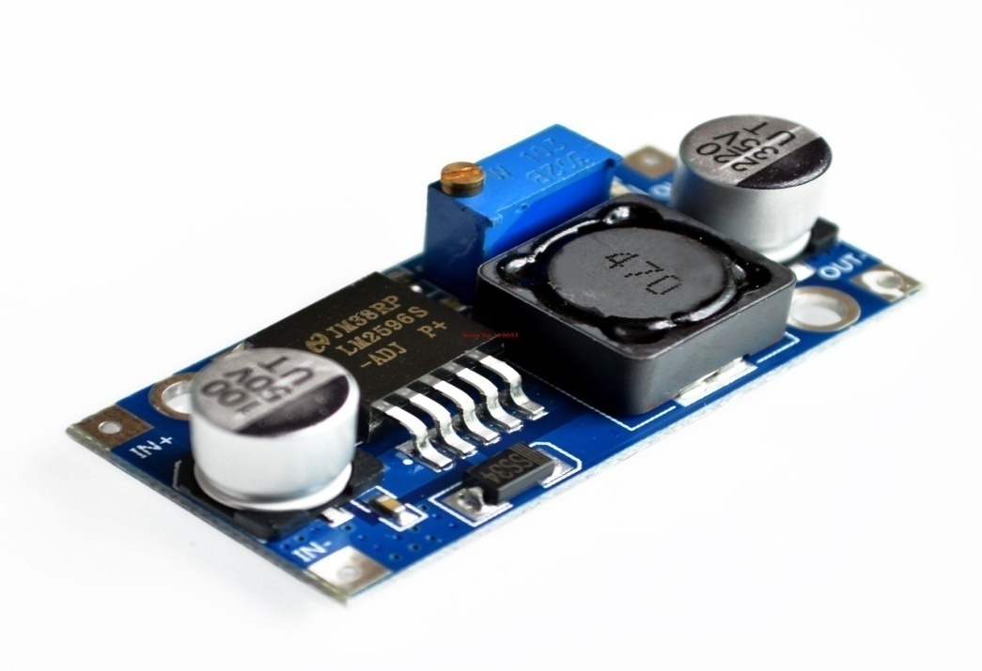
Voltage Stabilizer
The LM2596 series of regulators with excellent line and load regulation. These devices are available in fixed output voltages of 3.3 V, 5 V, 12 V, and an adjustable output version.

Slide 22
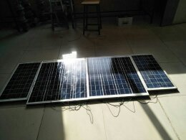
Solar Panels
Solar panels absorb the sunlight as a source of energy to generate electricity.

Slide 23
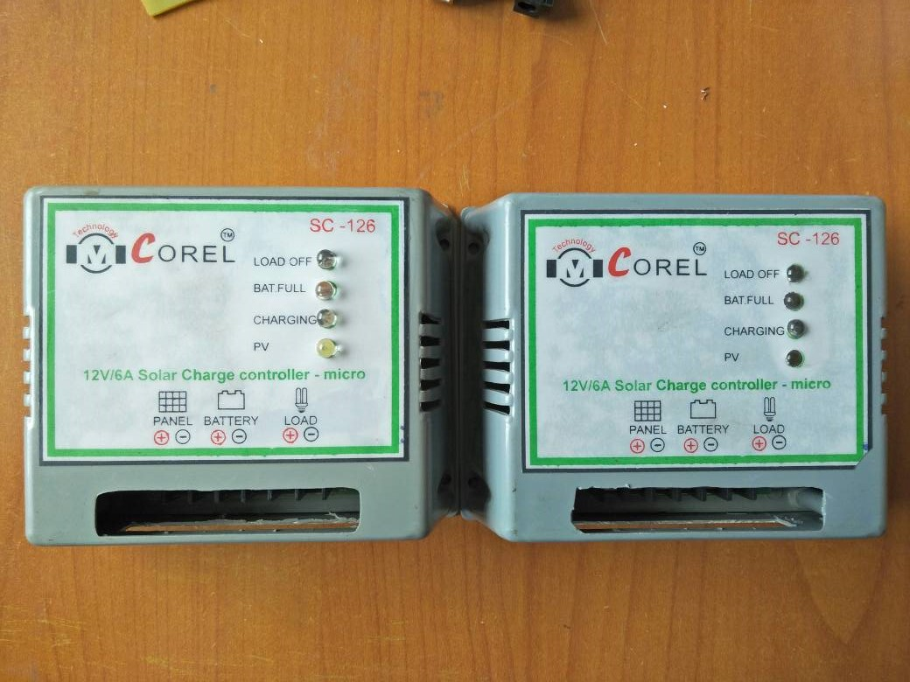
Solar Charge Controllers
It collects the electric energy from solar panel and after regulation it charges the battery and it also capable to drive load directly when battery is fully charged.

Slide 24
Battery & Inverter set
Battery: An electric battery is a device consisting of one or more electrochemical cells with external connections provided to power electrical devices such as DC loads.
Inverter: An electronic apparatus which converts direct current into alternating current.
Here we are using 12V, 80Ahr battery & 900VA/750W inverter to supply AC loads.

Slide 25
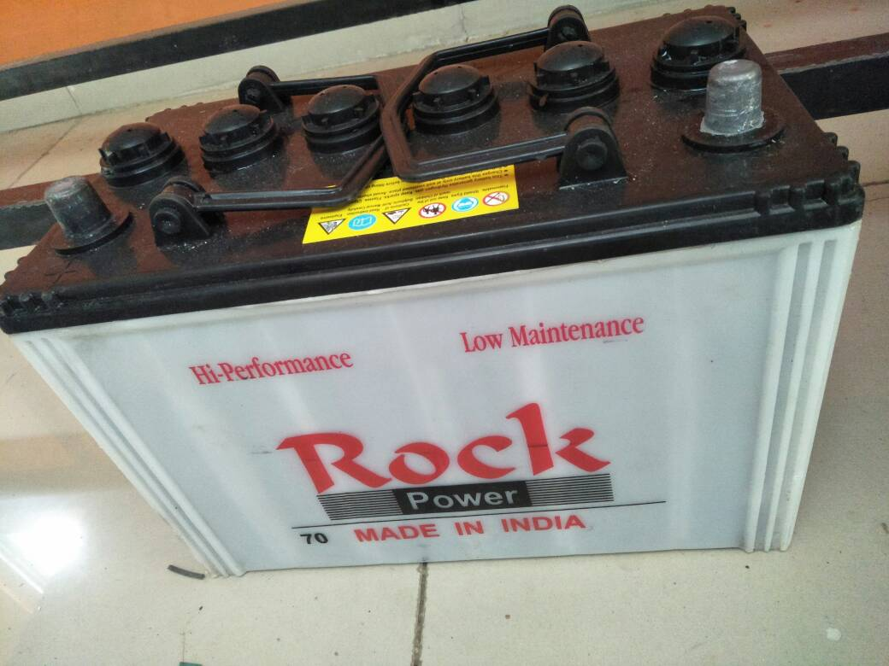
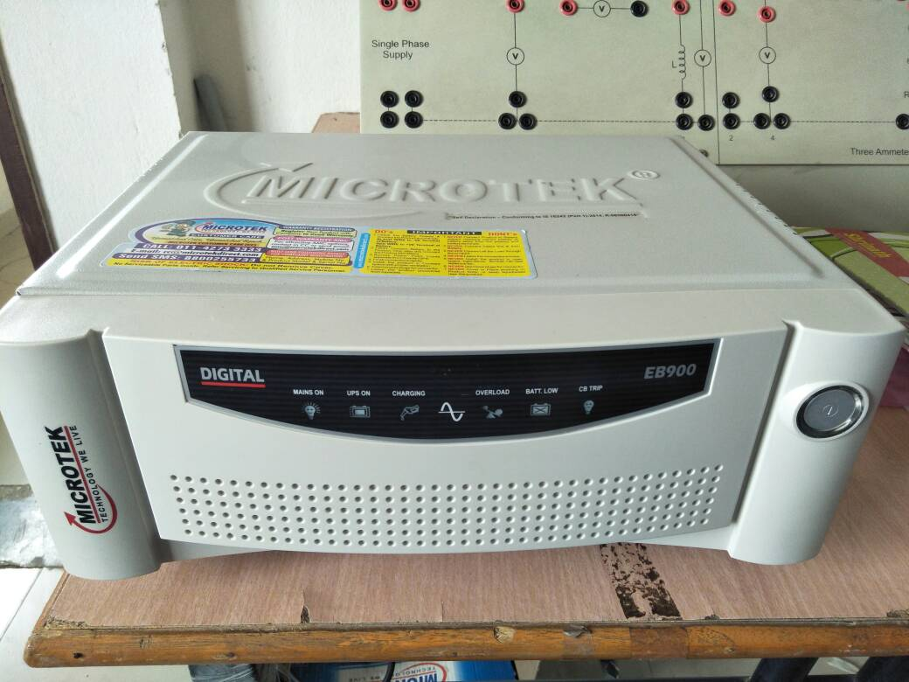

Slide 26
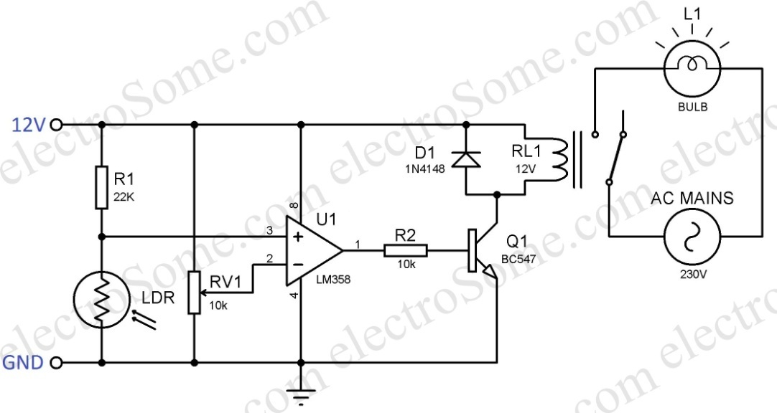
LDR based Automatic Switch
This circuit employed the output from an uncomplicated light/dark activated circuit and oblige a relay in its output. Which switch ON/OFF the Electric board supply when the sun light is not enough to charge battery with solar panels like in Rainy seasons.

Slide 27
Parameters Monitoring System
Here we are monitoring the parameters of our project by the use of Arduino with LCD display.
We used voltage sensors to read the voltage value of wind, solar & battery.
Two current sensors are used to measure the generating current by wind generator & solar panels.
Temperature sensor to sense the temperature at generators magnets side.
An IR sensors are used as a tachometer to moniter the RPM of air ventilator.

Slide 28
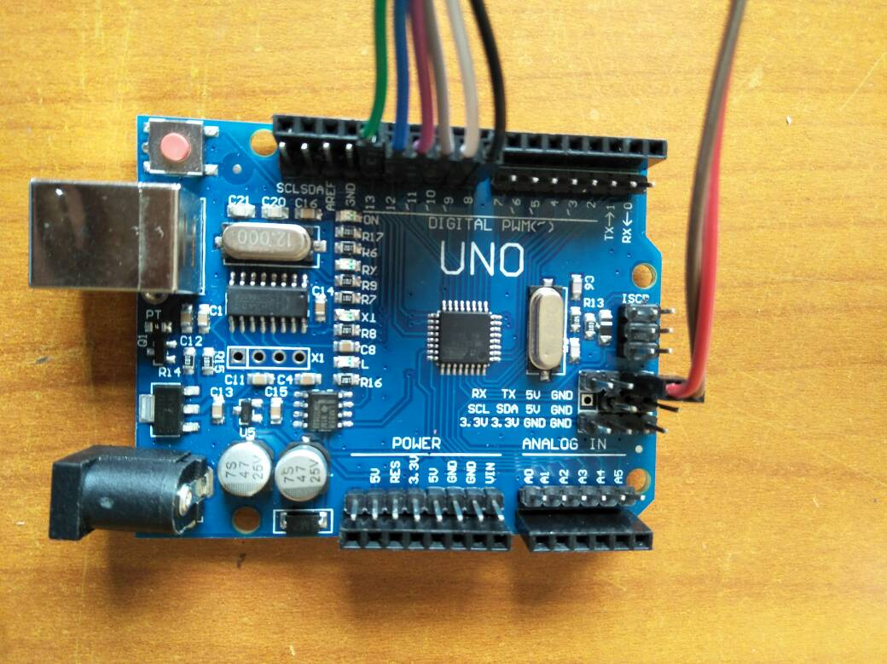
Arduino

Slide 29
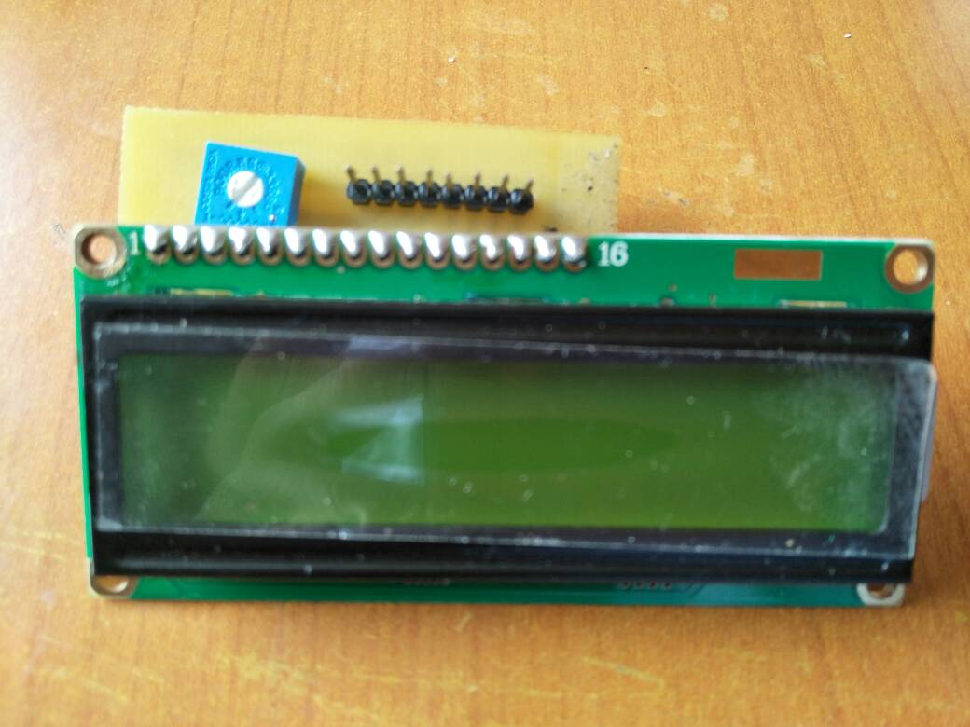
LCD(16*2) with Adapter

Slide 30
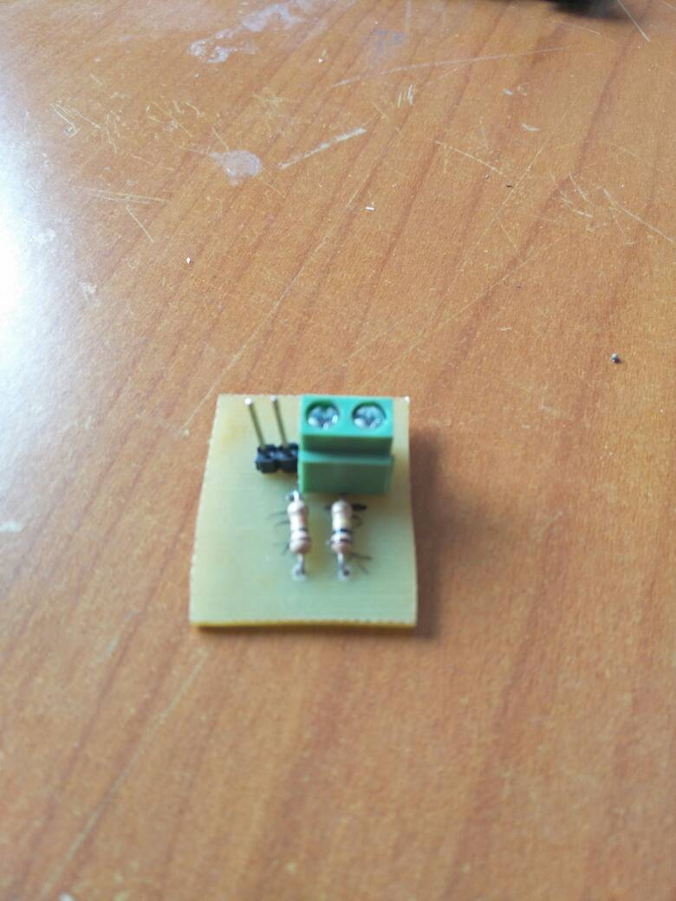
Voltage Sensor

Slide 31
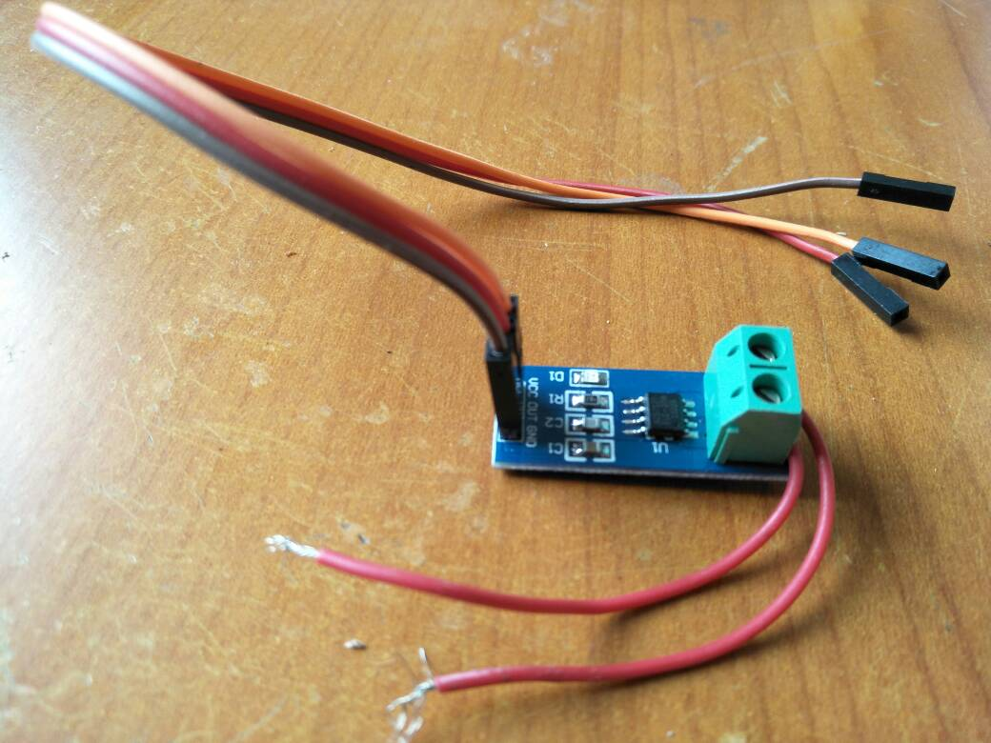
DC Current Sensor (ACS712)

Slide 32
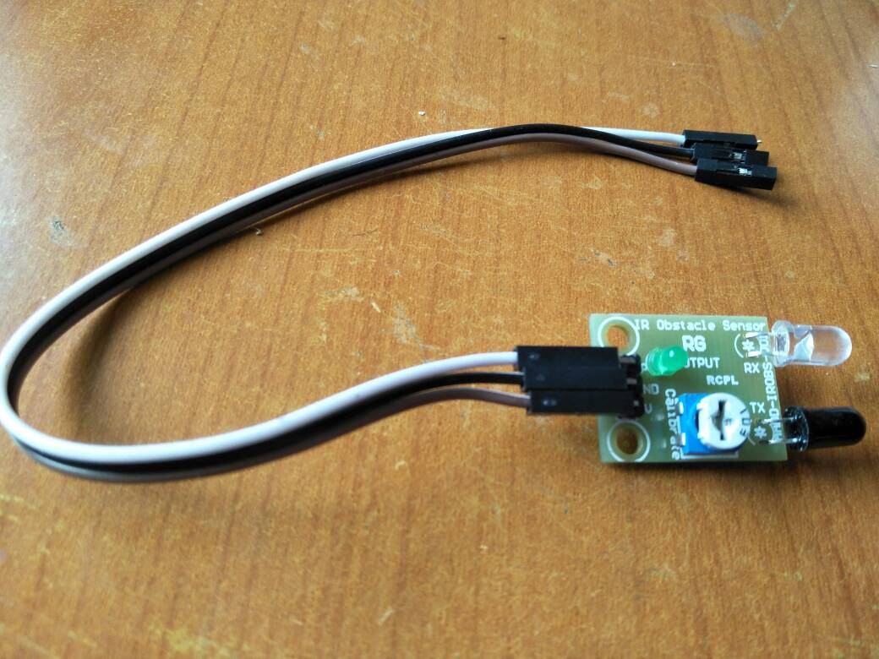
IR sensor

Slide 33
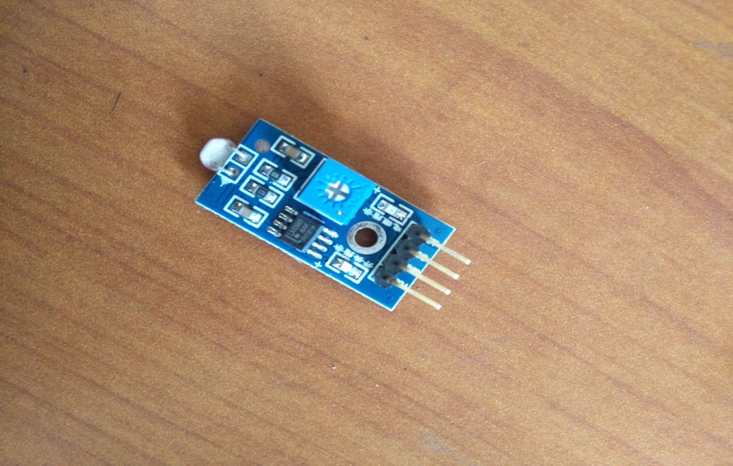
Temperature Sensor(lm35)

Slide 34
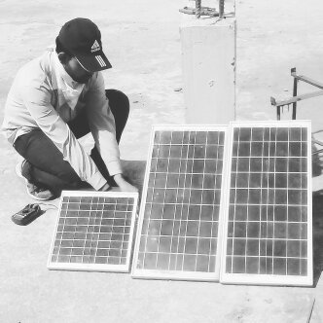

Working pictures

Slide 35
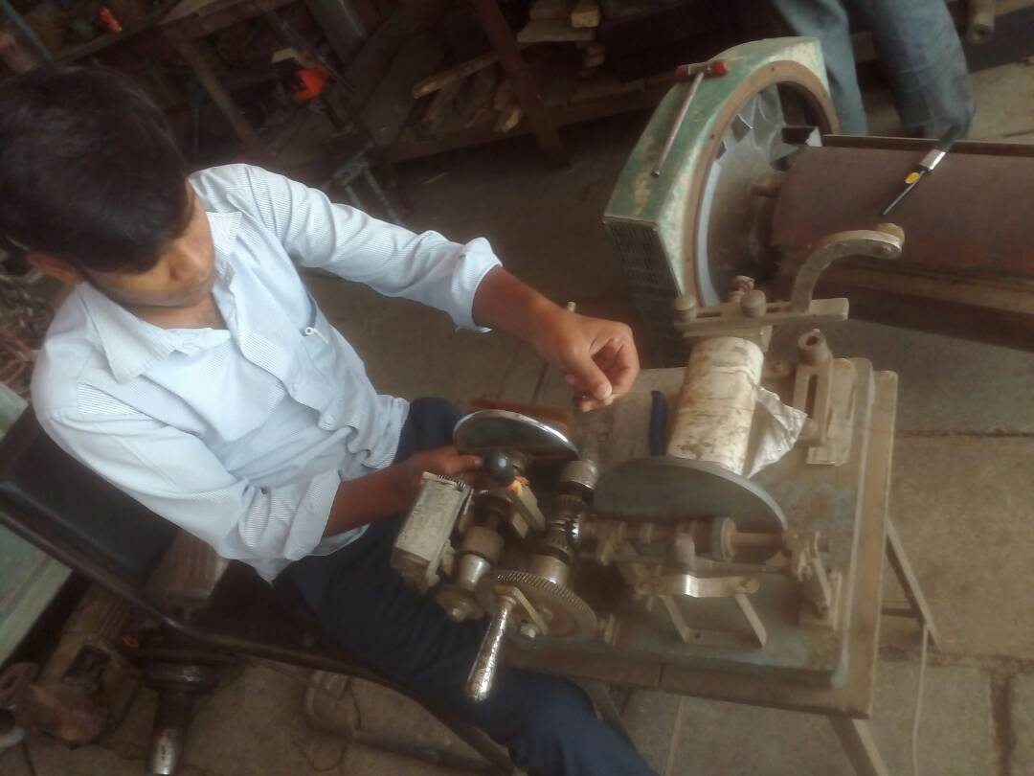
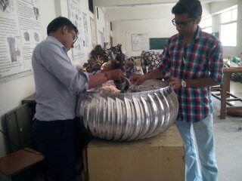

Slide 36
Applicatons & Advantages
Air ventilators can be used to ventilate exhaust air as well as generate electricity.
Since ventilators are in work for 24 hours therefore it can generate electricity even in night hours.
Can be used in industries, institutions etc. as air ventilators are the need of today’s scenario.
Uses clean energy as the source of generation.
Since the energy demand of the world is rising, therefore it can be further used for generation of renewable energy.

Slide 37


